Slide 1
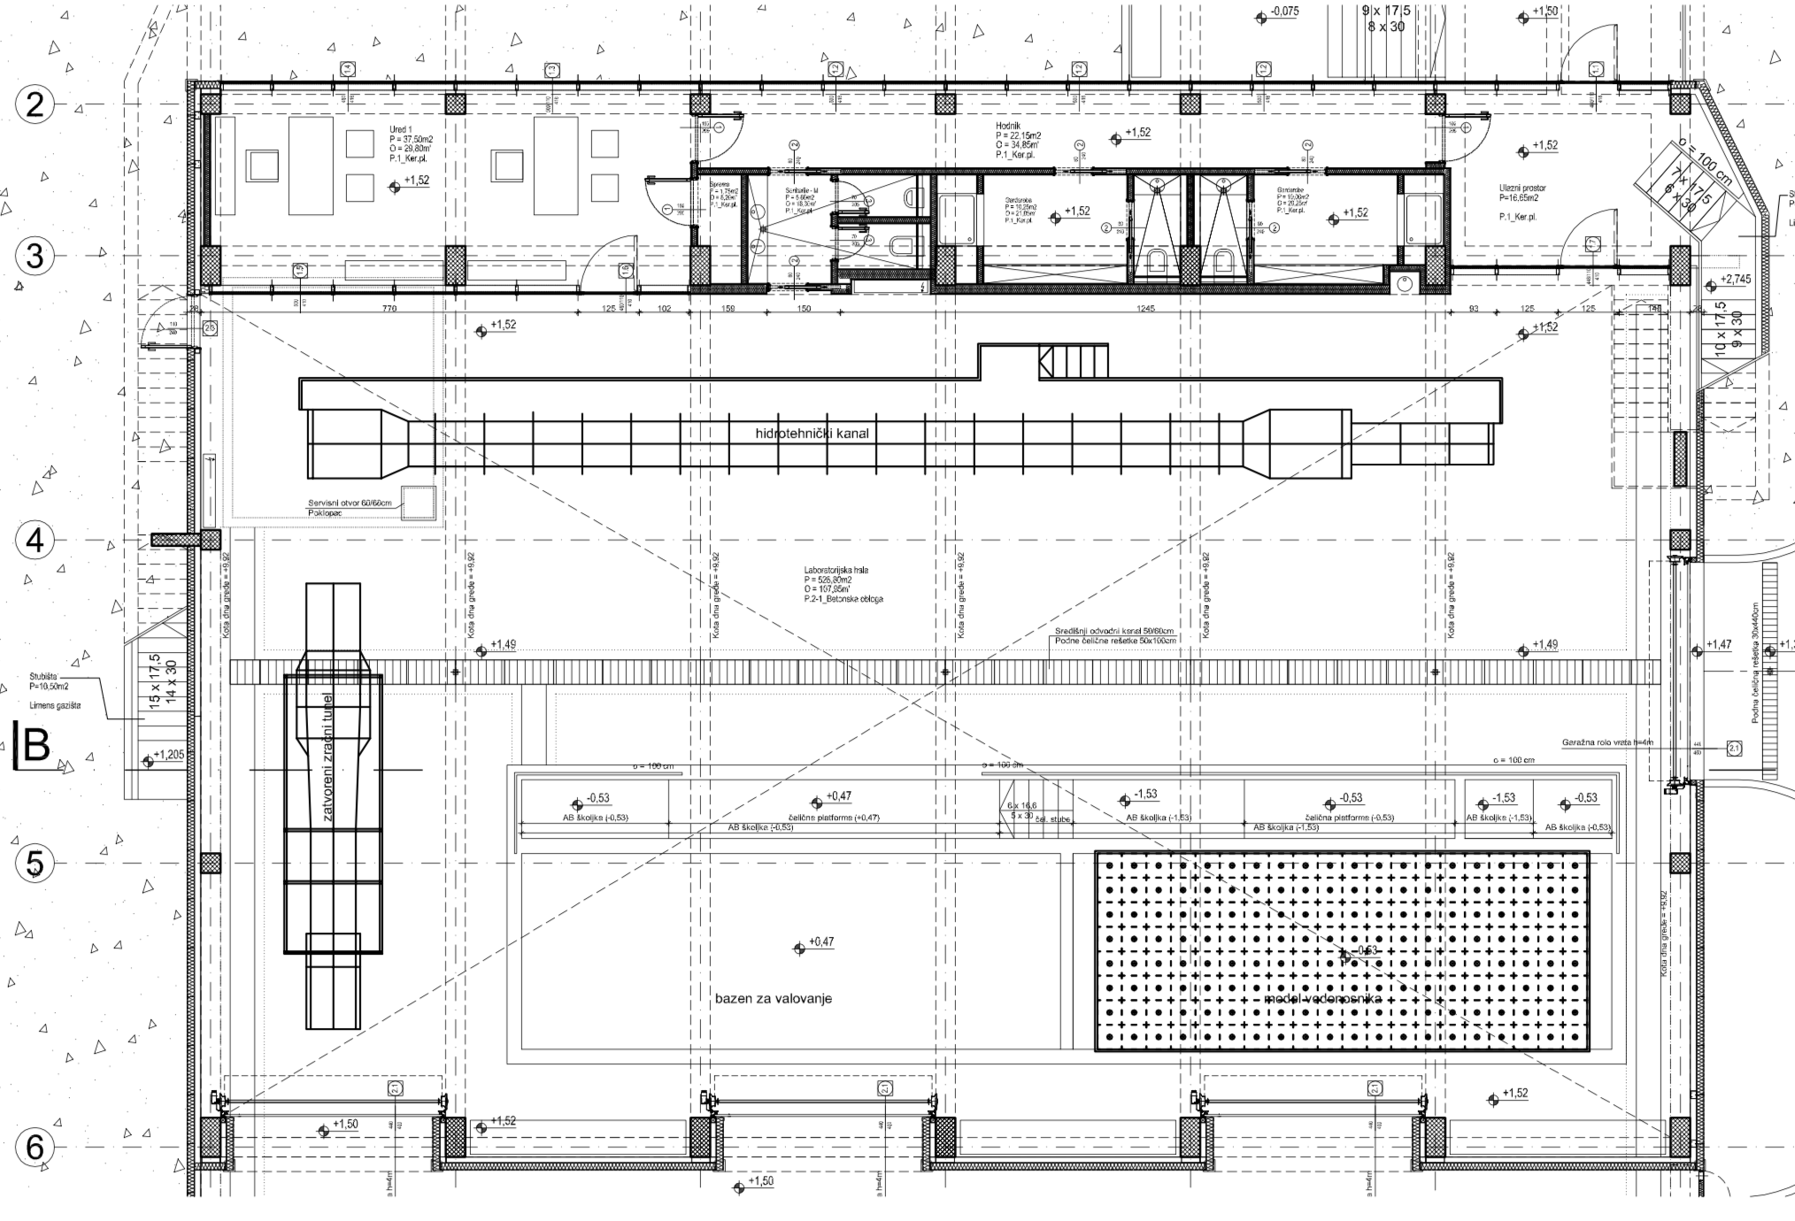
GROUND PLAN
❷
WAWE TANK – FLOW CHANNEL
WAWE TANK – AQUIFER MODEL
WIND TUNNEL
❶
❸

Slide 2
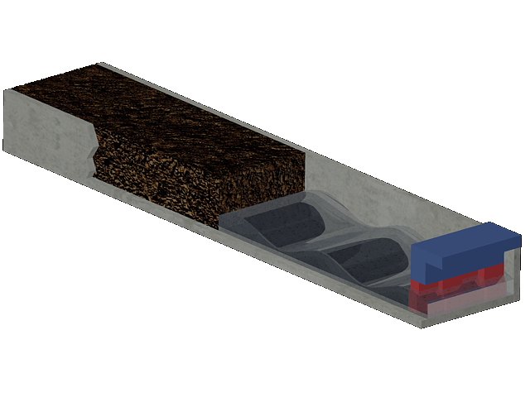
❶ WAWE TANK – AQUIFER MODEL
Karst aquifer model
8 Panel Wave Generator
Concrete pool 4 x 2,7 x 20 m
WAVE – COAST INTERACTION BASIN

Slide 3
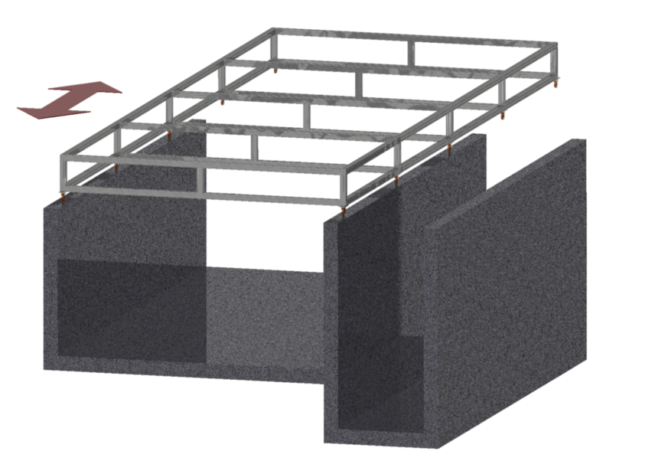
Frame construction for
supporting precipitation device
❶ WAWE TANK – AQUIFER MODEL
SLIDING DIRECTION
Agregate for simulating the
aquifer (removable)
Concrete shell (pool)
for placing the aquifer model
Service chamber

Slide 4
❶ WAWE TANK – AQUIFER MODEL
Rain Generator
8 Panel Wave Generator
Probes
Laser
Up to 20 metres
100 cm
4 metres

Slide 5
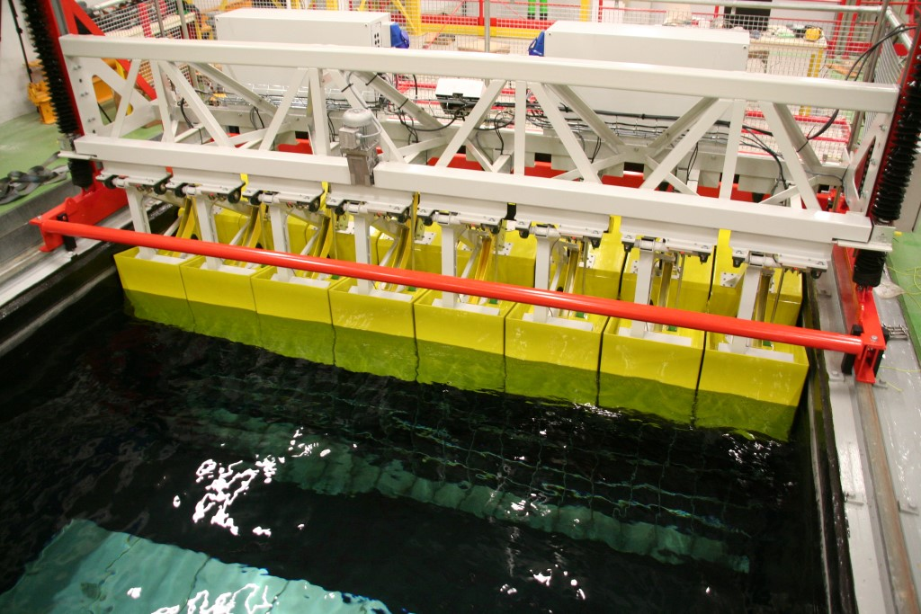
❶ WAWE TANK – AQUIFER MODEL
20 m long and 4 m wide concrete pool (max 2 m depth);
Operational depth can be changed and set up based on experiment requirements
Paddle-type wave genarator (8 independent paddles);
Designed to simulate real waves (spectral waves)
Fully controlled by software
Integrated monitoring system (64 hot wires)
Aquifer model with over 400 preassure meassuring points
Programable rain simulating platform over 40 m² area

Slide 6
❷ WAWE TANK – FLOW CHANNEL
The core element is the glass sided experimental section of 16000 mm in length, with 600 mm x 1200 mm cross section;
Re-circulation system for generating currents, alone or in combination with waves.
The main
application of the
flume will be the investigation
of wave phenomena with the
emphasis on deep water waves
and their impact on floating structures.
The flume should serve as a closed wave tank
(closed on both ends), but additionally have the
capability to produce current (flow) in both possible
directions.
This will allow to study wave phenomena with the addition of flow superposition to the wave propagation.

Slide 7
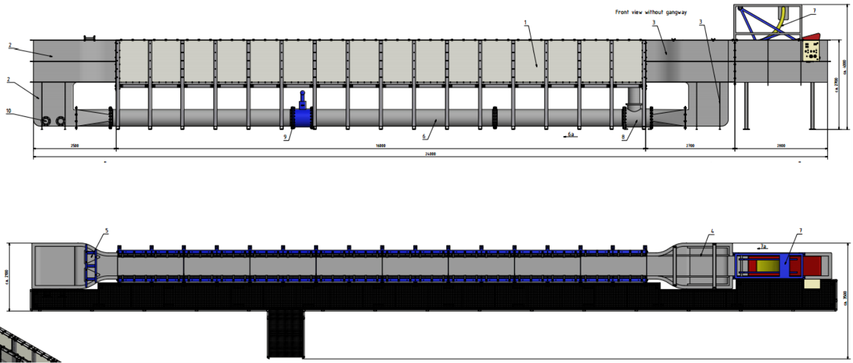
❷ WAWE TANK – FLOW CHANNEL
Side view
Top view

Slide 8
❷ WAWE TANK – FLOW CHANNEL
A flap-type wave generator will be installed at the far end of the end section, having a special compartment in order to accommodate the paddle and the driving mechanism;
The flap-type wave-maker is very suitable for deep water waves;
Synthesis software with the following features:
All common wave spectra provided
User can visualize waves virtually before performing the experiment
Fully customizable waves
Max. wave height: 300mm, through to crest at a period time between 1 to 2 sec;
Highest wave energy absorption in the range of 0,2 to 1,5Hz;
Monitoring system consists of real-time hot wire set placed along the flume.

Slide 9
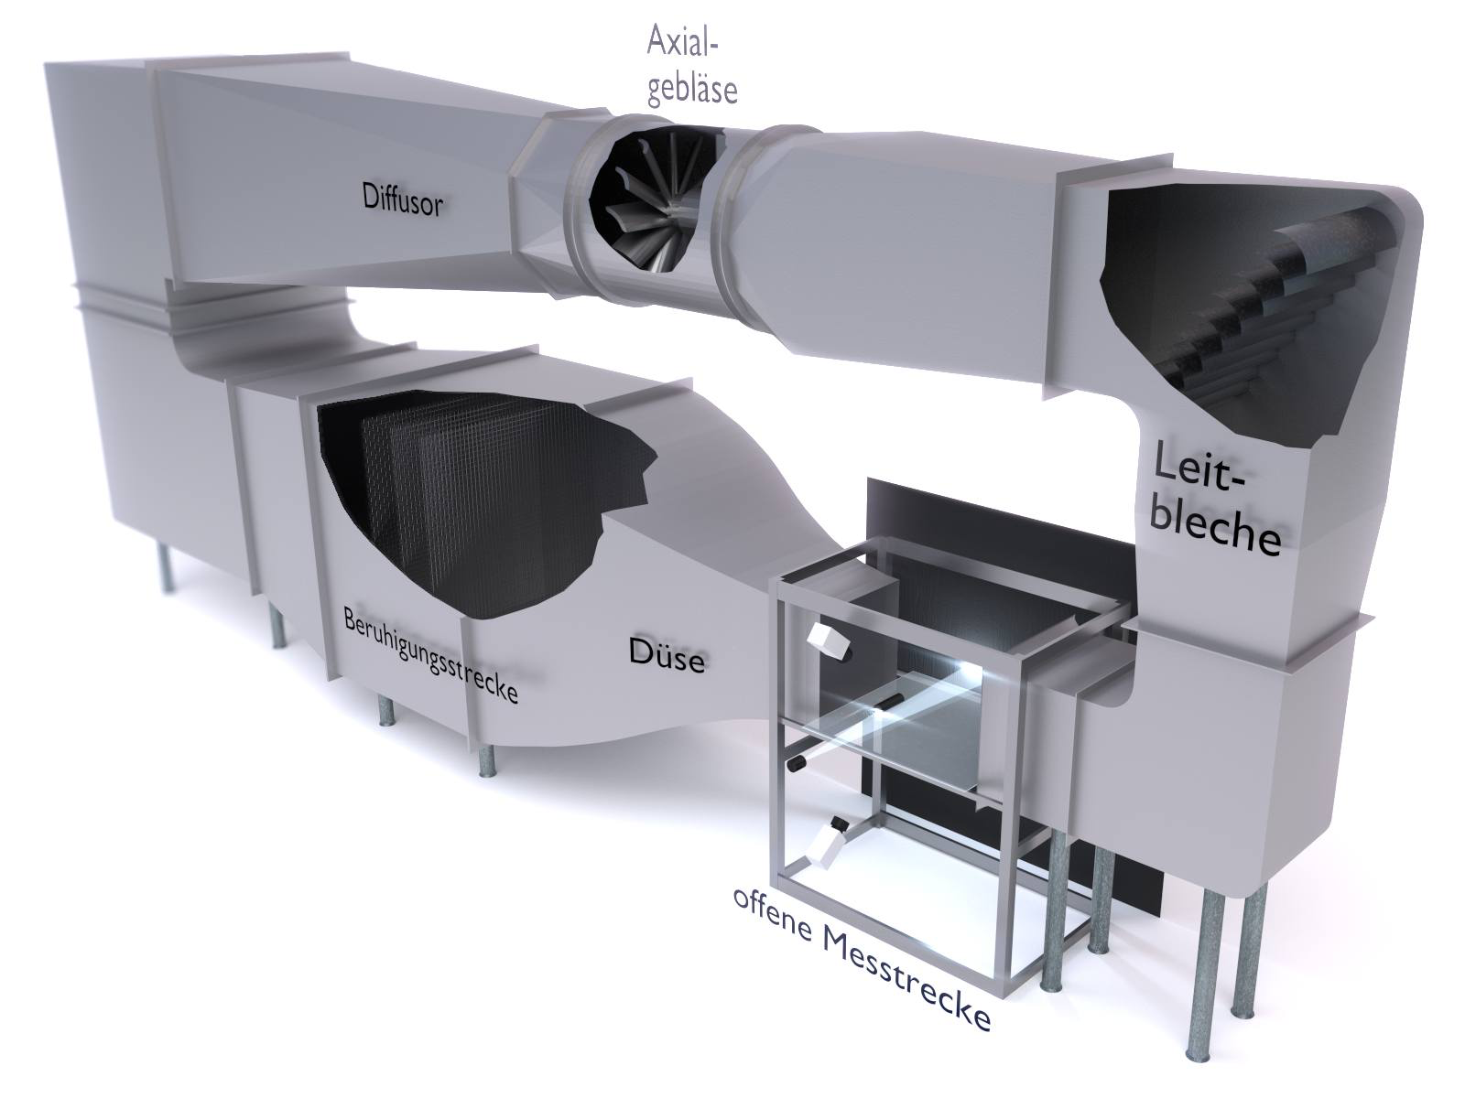
❸ WIND TUNNEL Göttinger-Type

Slide 10
M
❶ MEASURING TECHNOLOGIES, DATA ACQUISITION & EQUIPMENT
STEREOSCOPIC AND TOMOGRAPHIC PARTICLE IMAGE VELOCIMETRY (PIV)
PIV/LIF system:
4 high speed cMOS cameras (5.5 Megapixel scientific CMOS camera with dual-frame-technique for cross correlation with 120 ns min. time separation and sensor resolution: 2560 x 2160 pixel)
Nd:YAG double-cavity Laser (Nano TRL 425-10 PIV; pulse energy: 2x 425 mJ; wavelength: 532 nm;repetition rate: 10 Hz)

Slide 11
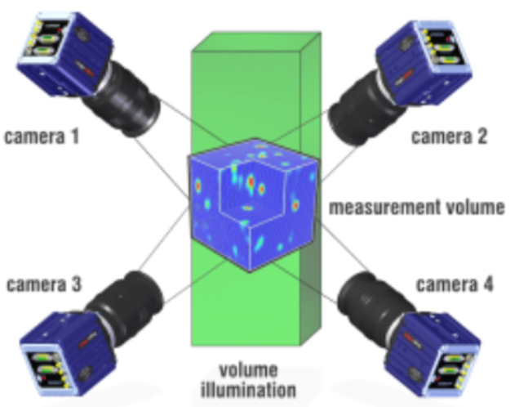
M
❶ MEASURING TECHNOLOGIES, DATA ACQUISITION & EQUIPMENT
STEREOSCOPIC AND TOMOGRAPHIC PARTICLE IMAGE VELOCIMETRY (PIV)

Slide 12
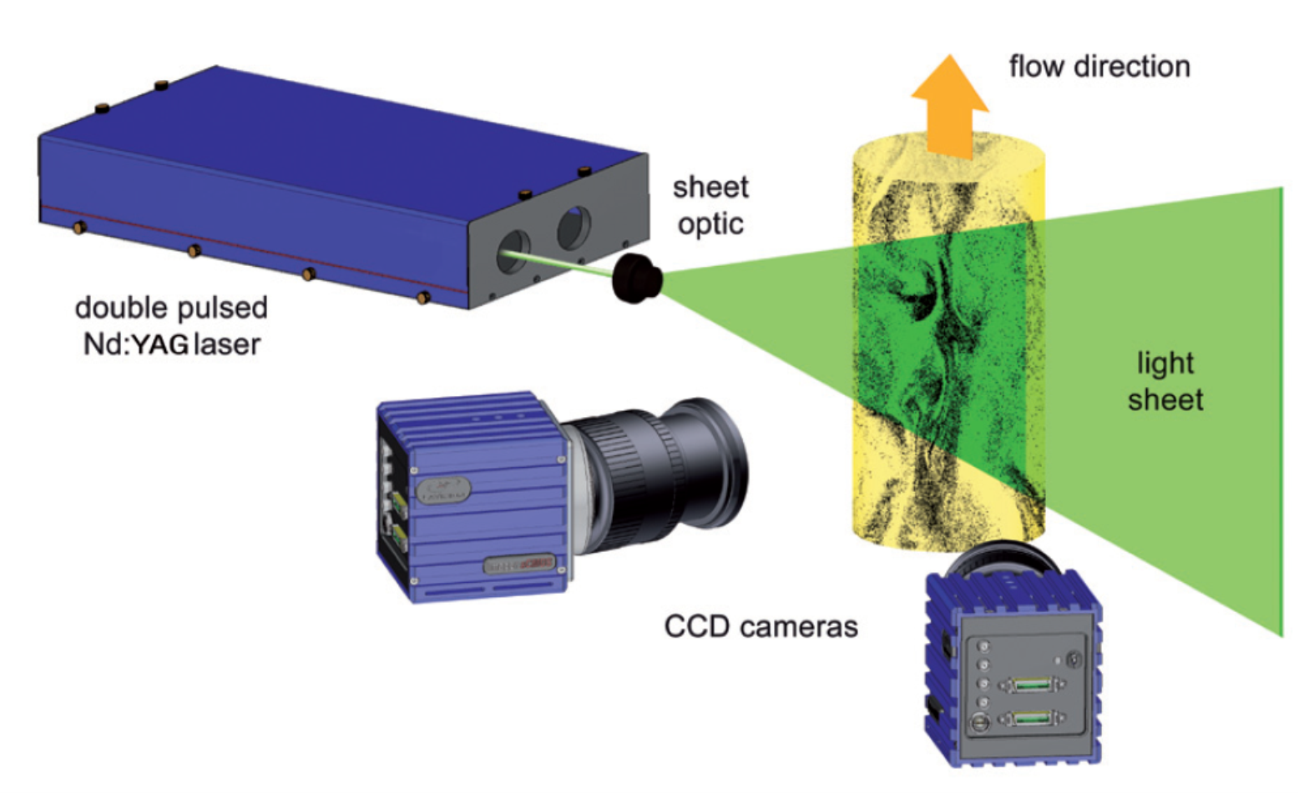
M
❶ MEASURING TECHNOLOGIES, DATA ACQUISITION & EQUIPMENT
STEREOSCOPIC AND TOMOGRAPHIC PARTICLE IMAGE VELOCIMETRY (PIV)

Slide 13
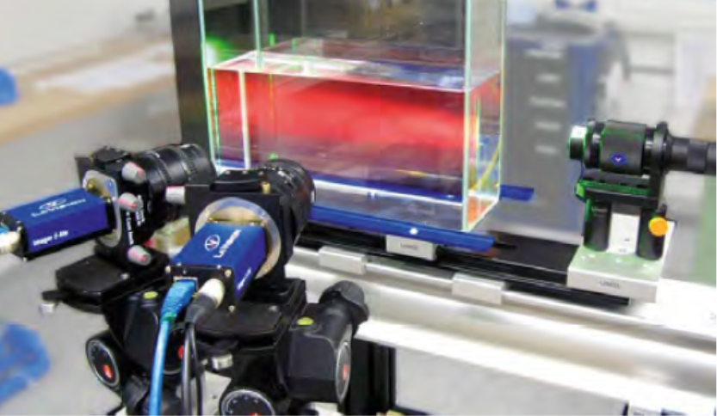
M
❶ MEASURING TECHNOLOGIES, DATA ACQUISITION & EQUIPMENT
LASER INDUCED FLUORESCENCE(LIF)
LIF system:
Laser imaging systems measure scalar flow properties such as concentration, mixture fraction, fluid composition and temperature in various fluid dynamical applications. For scalar laser imaging in fluids Laser Induced Fluorescence (LIF) is the most versatile and practical measurement technique featuring high signal levels and spectral selectivity

Slide 14
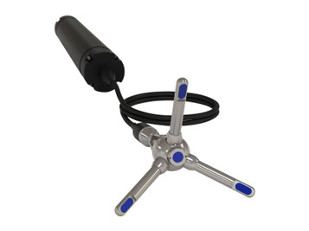
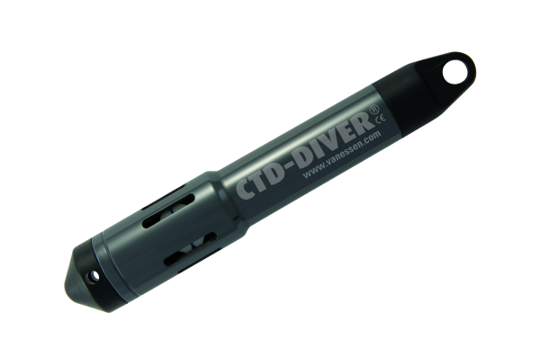
❶ MEASURING TECHNOLOGIES, DATA ACQUISITION & EQUIPMENT
OTHER AUXILIARY MEASUREMENT EQUIPMENT
ADV meters (5 pcs.)
Pressure sensors (400 pcs.)
CTD divers (60 pcs.)
Resistance Wawe Gauges (72 pcs.)

Slide 15
The research fields and the resulting outcomes will be of a great value for public health issues, environmental protection, water availability and food production on the local and regional sale.
Coastal processes of sea and land interaction
Environmental engineering, environmental protection
Testing and design of coastal constructions
Coastal erosion phenomenon
Longshore and cross shore beach sediment transport
Hydrological processes within the karstic terrain
Contaminant transport within the karstic terrain
Saltwater intrusion
Deep-water waves and shallow-water waves research
Interaction of sea with the karst aquifer

